Slide 1




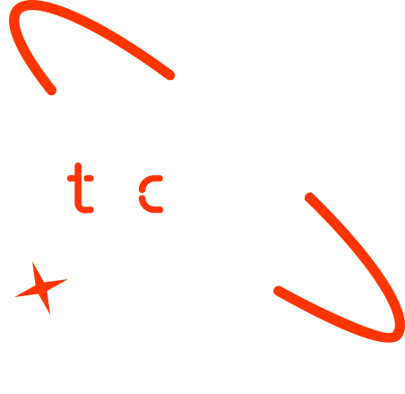

ML-Based Rainfall Forecasting
and Deployment for
Climate-Smart Agriculture
Graduate Name
1. Selam Kiflay
2. Ketim Teklu
3. Abdi Gonfa
4. Hilina Amare

Slide 2

Outline
Concept note and implementation plan
Background
Objectives
SDG Relation
Data
Data Collection
Exploratory Data Analysis et Feature Engineering
Model
Model Selection and Training
Model Evaluation and Hyperparameter Tuning
Model Refinement and Testing
Results
Evaluation Results
Deployment
Future Work

Slide 3
Concept note and Implementation Plan
Notes:
FTs like precision agriculture, remote sensing & AI-powered forming equipment can help increase agricultural productivity in LDCs. This can improve fiid security & contribute to the achievement of SDG 2 (Zero Hunger).

Slide 4
Background
Erratic rainfall poses serious challenges to agriculture and water management, especially in regions with unpredictable climates. This unpredictability threatens food security and livelihoods.
Traditional forecasting methods, like statistical models or manual weather reports—often fall short due to limited data and low accuracy.
Our project addresses this gap by leveraging machine learning to combine key weather features such as humidity and temperature. It also integrates real-time data via APIs to generate precise, location-based rainfall predictions.
The result is a simplified, user-friendly system that provides more accurate, actionable forecasts than conventional tools.

Slide 5
Objectives
Build an accurate model to predict rainfall probability
Inputs: country, city, and date only
Use accessible datasets for scalability
Historical weather records
Real-time weather APIs
Provide clear visualizations (e.g., prediction distributions)
To effectively communicate results to stakeholders
Support agricultural resilience
Enable better planning and resource management through timely forecasts
Notes:
FTs like precision agriculture, remote sensing & AI-powered forming equipment can help increase agricultural productivity in LDCs. This can improve fiid security & contribute to the achievement of SDG 2 (Zero Hunger).

Slide 6

SDG Relation
Precision agriculture: Accurate rainfall forecasts help farmers determine the best planting and harvesting times.
Efficient irrigation: Anticipating rainfall allows for optimized water usage, reducing waste and improving crop yield.
Reduced crop failure: Predicting heavy or scarce rainfall can mitigate risks by enabling early preparation.
Data-driven decisions: Farmers and agricultural planners can make smarter choices based on forecast trends and weather patterns.
Notes:
FTs like precision agriculture, remote sensing & AI-powered forming equipment can help increase agricultural productivity in LDCs. This can improve fiid security & contribute to the achievement of SDG 2 (Zero Hunger).

Slide 7

SDG Relation
Adapting to climate variability: In countries facing shifting rainfall patterns due to climate change, timely predictions offer critical preparedness.
Disaster risk reduction: Early warnings for droughts or floods reduce the socio-economic impact on vulnerable communities.
Sustainable planning: Enables long-term decisions in agriculture, urban planning, and water resource management.
Environmental data integration: Real-time weather data enhances adaptive capacity in regions sensitive to climatic shifts.

Slide 8
Data
Notes:
FTs like precision agriculture, remote sensing & AI-powered forming equipment can help increase agricultural productivity in LDCs. This can improve fiid security & contribute to the achievement of SDG 2 (Zero Hunger).

Slide 9
Data Collection
This project uses both historical and real-time weather data to train and validate a rainfall prediction model.
The training process is based on two key datasets: train.csv, which includes 2,190 daily records, and Rainfall.csv, containing essential weather features such as temperature, humidity, pressure, and rainfall.
Real-Time Forecasts: WeatherAPI, providing weather features (JSON) for user-specified locations and dates.
Notes:
FTs like precision agriculture, remote sensing & AI-powered forming equipment can help increase agricultural productivity in LDCs. This can improve fiid security & contribute to the achievement of SDG 2 (Zero Hunger).

Slide 10
Exploratory Data Analysis and Feature Engineering
EDA revealed key rainfall patterns, showing strong correlations with humidity (0.65) and an inverse relationship with temperature. Seasonal trends and a class imbalance (86% rainy days) were observed.
Visuals like histograms, time-series plots, and heatmaps confirmed humidity, pressure, and temperature as strong predictors.
Feature engineering included lagged variables (previous days’ humidity/temperature), seasonal indicators, and interaction terms (e.g., humidity × pressure). Day-of-year was encoded cyclically to reflect seasonal weather patterns.
These features enhanced the model’s ability to learn and predict rainfall accurately.
Notes:
FTs like precision agriculture, remote sensing & AI-powered forming equipment can help increase agricultural productivity in LDCs. This can improve fiid security & contribute to the achievement of SDG 2 (Zero Hunger).

Slide 11
Model
Notes:
FTs like precision agriculture, remote sensing & AI-powered forming equipment can help increase agricultural productivity in LDCs. This can improve fiid security & contribute to the achievement of SDG 2 (Zero Hunger).

Slide 12
Model Selection and Training
Random Forest was selected for its robustness in handling non-linear relationships and class imbalance, crucial for predicting rainfall, given that 86% of the dataset represents rainy days.
Justification:
Capable of modeling complex feature interactions (e.g., humidity and pressure).
Resilient to outliers and noisy weather data.
Provides interpretability through feature importance scores.
Training Approach:
Data Split: 80% for training, 20% for testing, with preserved temporal order.
Cross-Validation: 5-fold time-series cross-validation to prevent data leakage.
Class Imbalance Handling: Applied balanced class weights to improve model fairness.

Slide 13
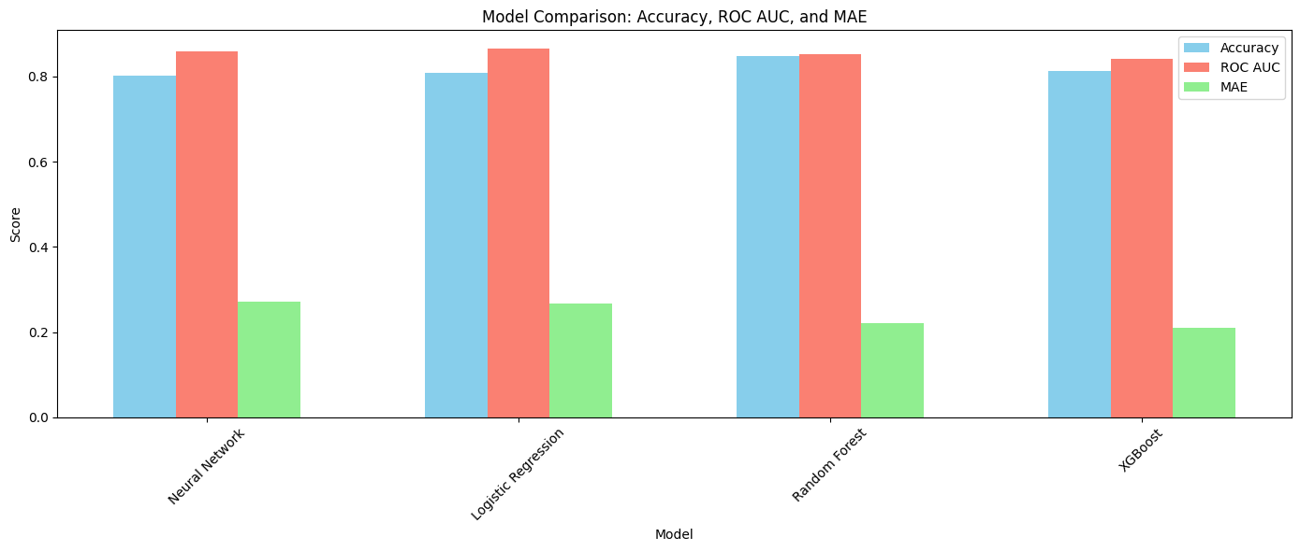
Model Selection and Training
Model | Accuracy | ROC AUC | MAE
Neural Network | 0.80 | 0.86 | 0.27
Logistic Regression | 0.81 | 0.87 | 0.27
Random Forest | 0.85 | 0.85 | 0.22
XGBoost | 0.81 | 0.84 | 0.21

Slide 14
Model Refinement and Testing
Class Weighting: Balanced weights improved prediction of non-rainy days.
Feature Pruning: Dropped low-importance features (e.g., wind direction), reducing model complexity.
Ensemble Attempt: Voting classifier (RF + Logistic Regression) tested, underperformed.
Test Dataset: test.csv aligned with train data, with identical preprocessing and engineered features.
Real-World Integration: WeatherAPI used to generate predictions for any date and location.
Test Results:
Accuracy: 85.10%
F1-Score: 0.83
AUC-ROC: 0.90
Notes:
FTs like precision agriculture, remote sensing & AI-powered forming equipment can help increase agricultural productivity in LDCs. This can improve fiid security & contribute to the achievement of SDG 2 (Zero Hunger).

Slide 15
Model Evaluation and Hyperparameter Tuning
Hyperparameters Tuned:
Parameters: Expanded n_estimators = [100, 200], maxdepth = [10, 15, 20], min_samples_split = [2, 5].
Technique: GridSearchCV with 10-fold expanding window cross-validation (TimeSeriesSplit).
Outcome:
Accuracy: 85.92%
F1-Score: 0.84
AUC-ROC (Validation): 0.91
Feature Selection: Removed features with importance < 0.05 → reduced from 12 to 8, cut training time by 15%.
Notes:
FTs like precision agriculture, remote sensing & AI-powered forming equipment can help increase agricultural productivity in LDCs. This can improve fiid security & contribute to the achievement of SDG 2 (Zero Hunger).

Slide 16
Results
Notes:
FTs like precision agriculture, remote sensing & AI-powered forming equipment can help increase agricultural productivity in LDCs. This can improve fiid security & contribute to the achievement of SDG 2 (Zero Hunger).

Slide 17
Evaluation Results
The refined model was evaluated across training, validation, and test datasets using key performance metrics: accuracy, F1-score, and AUC-ROC.
On the test set, the model achieved:
Accuracy: 85.10%
F1-score: 0.83
AUC-ROC: 0.90
These results closely align with training (85.92%, 0.84, 0.91) and validation (85.77%, 0.84, 0.91) performance, demonstrating strong generalization.
Despite a slight drop in accuracy due to test set variability, the consistently high AUC-ROC confirms the model's robustness and reliability in distinguishing rainfall events—making it well-suited for real-world deployment.
Notes:
FTs like precision agriculture, remote sensing & AI-powered forming equipment can help increase agricultural productivity in LDCs. This can improve fiid security & contribute to the achievement of SDG 2 (Zero Hunger).

Slide 18
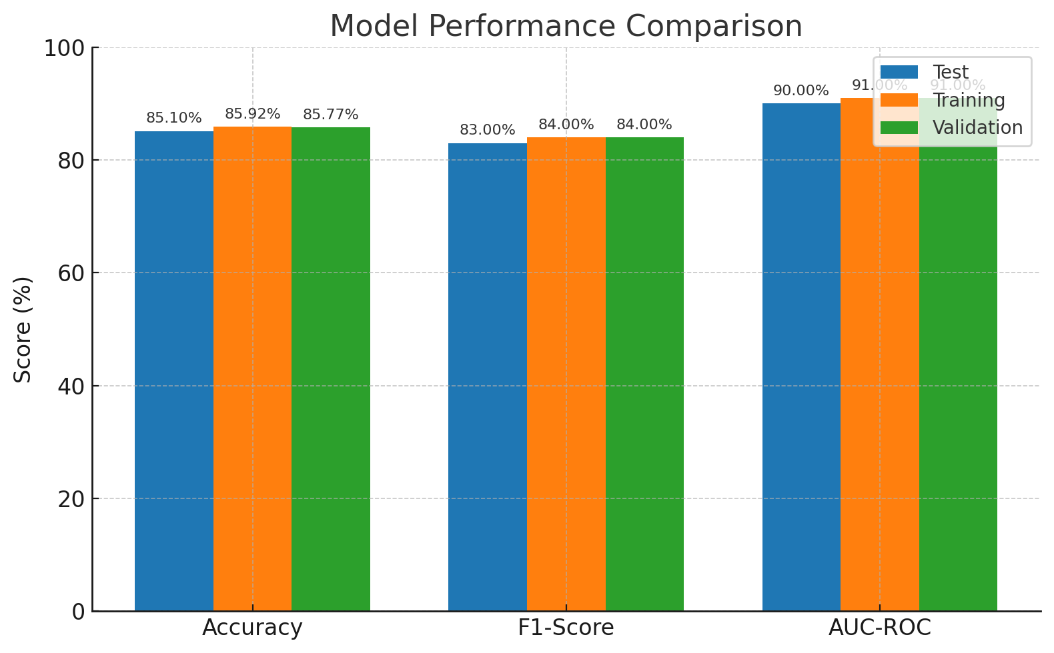
Evaluation Results
Metric | Test | Training | Validation
Accuracy | 85.10% | 85.92% | 85.77%
F1-Score | 0.83 | 0.84 | 0.84
AUC-ROC | 0.90 | 0.91 | 0.91
Notes:
FTs like precision agriculture, remote sensing & AI-powered forming equipment can help increase agricultural productivity in LDCs. This can improve fiid security & contribute to the achievement of SDG 2 (Zero Hunger).

Slide 19
Deployment
The deployment phase transitions the rainfall prediction model into a real-world application, enabling agricultural users, such as farmers, to access daily rainfall forecasts.
For the project, we developed the user interface using Streamlit, enabling seamless interaction with the rainfall prediction model.
Notes:
FTs like precision agriculture, remote sensing & AI-powered forming equipment can help increase agricultural productivity in LDCs. This can improve fiid security & contribute to the achievement of SDG 2 (Zero Hunger).

Slide 20
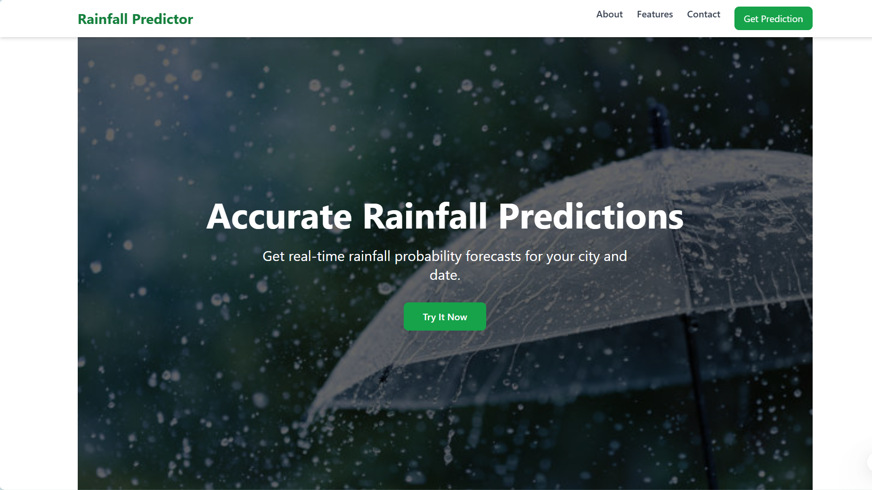
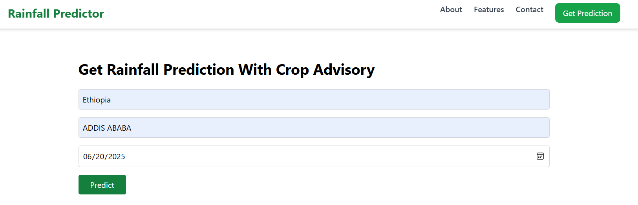
Deployment
Notes:
FTs like precision agriculture, remote sensing & AI-powered forming equipment can help increase agricultural productivity in LDCs. This can improve fiid security & contribute to the achievement of SDG 2 (Zero Hunger).

Slide 21
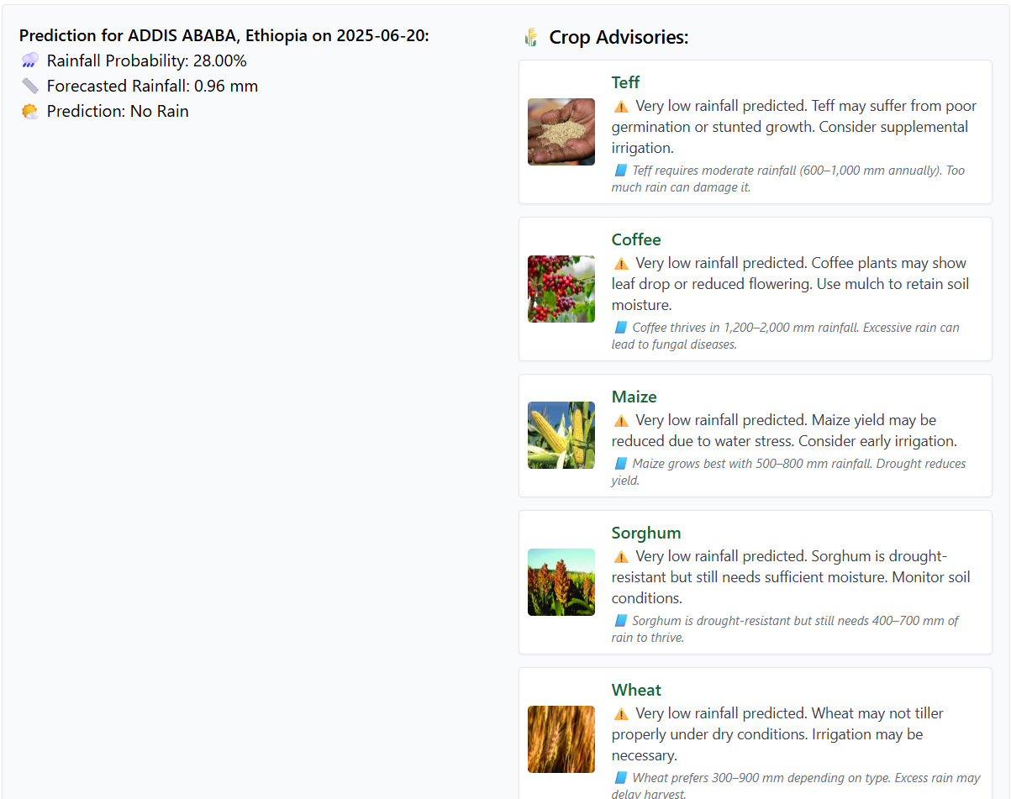
Deployment
Notes:
FTs like precision agriculture, remote sensing & AI-powered forming equipment can help increase agricultural productivity in LDCs. This can improve fiid security & contribute to the achievement of SDG 2 (Zero Hunger).

Slide 22
Future Work
We plan to expand the dataset to cover more regions and time periods, improving model accuracy. Future enhancements include adding features like wind patterns and soil moisture, integrating with mobile platforms, and enabling offline and multilingual access.
These steps aim to boost usability and support climate-resilient farming decisions.
Notes:
FTs like precision agriculture, remote sensing & AI-powered forming equipment can help increase agricultural productivity in LDCs. This can improve fiid security & contribute to the achievement of SDG 2 (Zero Hunger).

Slide 23
References
[1]Kim, J., et al. (2020). Ensemble Methods for Rainfall Prediction. Journal of Environ- mental Data Science, 12(4), 45–58.
[2]Lee, S., et al. (2021). Neural Networks for Weather Forecasting. Climate Modelling, 19(2), 101–115.
[3]Pedregosa, F., et al. (2011). Scikit-learn: Machine Learning in Python. Journal of Ma- chine Learning Research, 12, 2825–2830.
[4]Abadi, M., et al. (2016). TensorFlow: A System for Large-Scale Machine Learning.
12th USENIX Symposium on OSDI, 265–283.
[5]WeatherAPI. (n.d.). Real-Time Weather and Forecast Data.
Notes:
FTs like precision agriculture, remote sensing & AI-powered forming equipment can help increase agricultural productivity in LDCs. This can improve fiid security & contribute to the achievement of SDG 2 (Zero Hunger).

Slide 24


Thank you!

